Slide 1
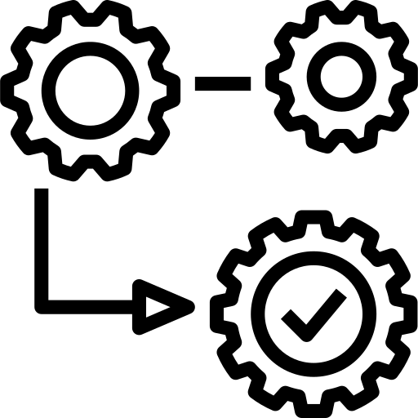
Functions Advanced
SoftUni Team
Technical Trainers
Software University
https://softuni.bg

Slide 2
Table of Contents
Packing Arguments
*args and **kwargs
Unpacking Arguments
Unpacking Lists and Tuples
Unpacking Dictionaries
Recursion
2
Notes:
2

Slide 3
Have a Question?
sli.do
#python-advanced

Slide 4
Packing Arguments
*args
**kwargs
*args and **kwargs

Slide 5
What is Packing?
This operation is called packing
We pack all the arguments into one single variable
We use packing when we don't know how many arguments need to be passed to a function
def some_func(*args, **kwargs):
pass
5

Slide 6
Packing Arguments into Tuple
We use *args to pack arguments into tuple
def some_func(*args):
print(args)
some_func(1, 2, 3) # (1, 2, 3)
some_func("peter", "george") # ("peter", "george")
some_func(True, False) # (True, False)
some_func() # ()
6

Slide 7
Packing Arguments into Dictionary
**kwargs allows you to pass keyworded variable length of arguments to a function
def greet_me(**kwargs):
for key, value in kwargs.items():
print(f"{value}, {key}")
greet_me(Peter="Hello", George="Bye")
# Hello Peter
# Bye George
7

Slide 8
Formal Args, *args and **kwargs
You can also use keyword arguments and *args
So, if you want to use all three of these in argument types then the order is
def some_func (arg1, *rest_args):
print(arg1 + sum(rest_args))
some_func(5, 5, 10) # 20
some_func() # Error
The function requires at least 1 argument
some_func(fargs, *args, **kwargs)
8

Slide 9
Problem: Multiplication Function
Write a function called multiply() that can receive any number of numbers (integers) as different parameters
The function should return the result of the multiplication of all of them
Submit only your function in judge
print(multiply(1, 4, 5))
print(multiply(4, 5, 6, 1, 3))
print(multiply(2, 0, 1000, 5000))
20
360
0

Slide 10

Solution: Multiplication Function
def multiply(*args):
result = 1
for num in args:
result *= num
return result
10

Slide 11
Unpacking Arguments
*
**
Unpack Lists, Tuples and Dictionaries

Slide 12
What is Unpacking?
We can use * to unpack the list so that all elements of it can be passed as different parameters
And we can use ** to unpack a dictionary, so all of its elements are passed as keyworded arguments
12

Slide 13
Unpacking Lists
Note that the length of the list, that you unpack, must be the same as the number of parameters in the function
def print_nums(a, b, c):
print(a, b, c)
nums = [1, 2, 3]
print_nums(*nums) # 1 2 3
13

Slide 14
Unpacking Dictionaries
Note that the keys of the dictionary must match the names of the parameters of the function
The order of the keys in the dictionary does not matter
def some_func(name, age):
print(f"{name} is {age} years old")
person = {'age': 20, 'name': "Peter"}
some_func(**person) # Peter is 20 years old
14

Slide 15
Problem: Person Info
Write a function called get_info that receives a name, age and town, and returns a string in the format: "This is {name} from {town} and he is {age} years old"
Use dictionary unpacking when testing your function
kwargs = {"name": "John", "town": "Sofia", "age": 20}
print(get_info(**kwargs))
This is John from Sofia and he is 20 years old

Slide 16

Solution: Person Info
def get_info(name, age, town):
return f"This is {name} from {town} and he is {age} years old"
# TEST CODE
print(get_info(**{"name": "George", "town": "Sofia", "age": 20}))
16

Slide 17

Advanced Sorting

Slide 18
sorted()
The sorted() method sorts the elements of a given iterable - Ascending or Descending
iterable - sequence or collection or any iterator
key - function that serves as a key for the sort comparison
reverse - If =True, the sorted list is reversed (or sorted in Descending order)
By default
sorted(iterable, key=None, reverse=False)
By default
18

Slide 19
Sorting Dictionary by Key
Using lambda to sort by key element
Using reverse to sort dictionary by key in descending order
my_dict = {'Peter': 21, 'George': 18, 'John': 45}
sorted_dict = sorted(my_dict.items(), key=lambda x: x[0])
# [('George', 18), ('John', 45), ('Peter', 21)]
reversed_dict = sorted(my_dict.items(),
key=lambda x: x[0],
reverse=True)
# [('Peter', 21), ('John', 45), ('George', 18)]
19

Slide 20
Sorting Dictionary by Value
Using lambda to sort by value element
You could use "-" instead of reverse when sorting descending
my_dict = {'Peter': 21, 'George': 18, 'John': 45}
sorted_dict = sorted(my_dict.items(), key=lambda x: x[1])
# [('George', 18), ('Peter', 21), ('John', 45)]
reversed_dict = sorted(my_dict.items(), key=lambda x: -x[1])
# [('John', 45), ('Peter', 21), ('George', 18)]
Works only with numbers
20

Slide 21

Problem: Cheese Showcase
Read the problem description from here
Create a function as described in the problem description and test it with the given examples
Submit only your function in the Judge system
21

Slide 22
Solution: Cheese Showcase
def sorting_cheeses(**cheeses_dict):
cheeses_dict = sorted(
cheeses_dict.items(),
key=lambda x: (-len(x[1]), x[0]))
result = []
for (cheese_name, quantities) in cheeses_dict:
result.append(cheese_name)
quantity_list = sorted(quantities, reverse=True)
result += quantity_list
return "\n".join([str(x) for x in result])
22

Slide 23

Nested Functions
Inner Functions and Closures

Slide 24
Functions Can Be Nested
Defined inside other functions
The inner function does not exist outside the function in which it's defined
Outer Function
def outside_function():
...
def inside_function():
...
...
Inner Function
24

Slide 25
Inner Function Example
def factorial(number):
if not isinstance(number, int) or number < 0:
return f"Sorry. 'number' is incorrect."
def inner_factorial(n):
fact = 1
for i in range(1, n + 1):
fact = fact * i
return fact
return inner_factorial(number)
Return the result of calling the inner function
25

Slide 26
Functions Can Return Functions
The inner function is no longer "hidden"
The outer function returns behavior
def outside_function():
...
def inside_function():
...
return inside_function
26

Slide 27
Function Returning Function Example
def calculator(operator):
def addition(a, b):
return a + b
def subtraction(a, b):
return a - b
if operator == "+":
return addition
elif operator == "-":
return subtraction
operation = calculator("+")
result = operation(2, 3)
print(result)
# 5
Returns a function depending on the operator
27

Slide 28
Lexical Closures
The inner function can capture and carry some of the parent function's state
def outside_function(number):
def inside_function():
return number
return inside_function
print(outside_function(10)()) # 10
28

Slide 29
Closures Example
def greeting(name):
hello = "Hello, "
def say_hi():
return hello + name
return say_hi
print(greeting("Peter")())
# Hello, Peter
29

Slide 30
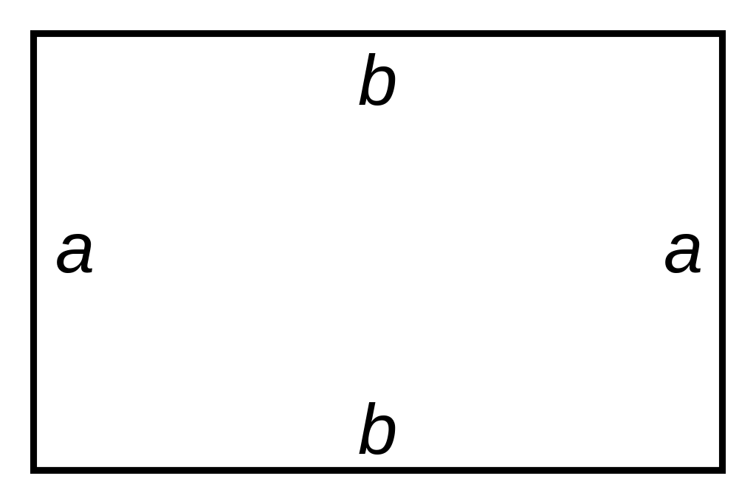
Problem: Rectangle
Read the problem description from here
Create a function as described in the problem description and test it with the given examples
Submit only your function in the Judge system
30

Slide 31

Recursion
Function Calling Itself

Slide 32
What is Recursion?
The process in which a function calls itself is called recursion
The function that is calling itself is called a recursive function
A recursive function has the following structure
A base case
A recursive case
32

Slide 33
Base Case and Recursive Case
The base case in a recursion returns a value without making any other recursive calls
It is the condition for the recursion to stop
The recursive case is the central part of the recursive function
It is the solution to the bigger problem expressed in terms of smaller problems
33

Slide 34
Example
Factorial recursive representation
def fact(n):
if n == 1:
return 1
return n * fact(n - 1)
Base Case
Recursive Case
34

Slide 35
Problem: Recursive Power
Create a recursive function called recursive_power()
It should receive a number and a power
Using recursion, return the result of number ** power
Submit only the function in the judge system
35

Slide 36
Solution: Recursive Power
def recursive_power(x, y):
result = 1
if y == 0:
return result
result = x * recursive_power(x, y - 1)
return result
36

Slide 37

Practice
Live Exercise in Class (Lab)

Slide 38

Summary
Packing arguments into:
Tuple
Dictionary
Unpacking arguments into:
Tuple
Dictionary
…
…
…

Slide 39
Questions?
Notes:
39

Slide 40












SoftUni Diamond Partners

Slide 41


Educational Partners

Slide 42
Trainings @ Software University (SoftUni)
Software University – High-Quality Education, Profession and Job for Software Developers
softuni.bg, softuni.org
Software University Foundation
softuni.foundation
Software University @ Facebook
facebook.com/SoftwareUniversity
Software University Forums
forum.softuni.bg
42
Notes:
42

Slide 43

License
This course (slides, examples, demos, exercises, homework, documents, videos and other assets) is copyrighted content
Unauthorized copy, reproduction or use is illegal
© SoftUni – https://about.softuni.bg
© Software University – https://softuni.bg
Notes:
43

